Slide 1
UNIT :9 Object Recognition
Prepared By
Er.Harendra Bikram Shah
(Lecturer)
Department of Computer Engineering

Slide 2
OUTLINES
Introduction to object recognition
Classification of Object Recognition
Neuron ,Neural Network and ANN
Application of NN in Image Processing

Slide 3
Introduction to object recognition
Object recognition is the task of finding and identifying the object in images or sequence of images
The main goal is to identify or recognize the specific object instantly.
Application of Object Recognition in Real Life:
Object Tracking
Counting objects
Automated CCTV surveillance
Person and Vehicle Detection

Slide 4
Classification of object recognition
Two major types of classification:
Unsupervised Classification (no target ,no teacher, NO training set) Example Clustering and Association
Supervised Classification
Statistical Supervised Classification (Bayesian Classifier ) Based on probability and hypothesis
Distribution free Supervised Classification (Nearest Neighbourhood classification) based on query given to system.

Slide 5
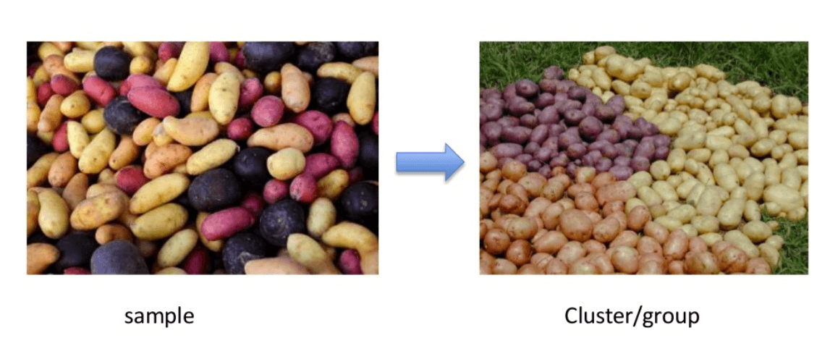
Unsupervised Classification
No target ,No teacher, No training set
Example Clustering and Association
Clustering Unsupervised Classification works by making the cluster of some features in the given items

Slide 6
Unsupervised Classification
Association works on large dataset by finding interesting relationships between variables in large databases
Application of Unsupervised Classification:
Anomaly Detection
automatic splitting the dataset into groups base on their similarities.
Data pre-processing for reducing no of data items or values.

Slide 7
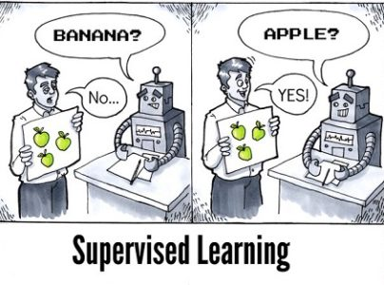
Supervised Classification
Based on Teacher, Training Set, Target
Two Types
Statistical Supervised Classification: Based on Hypothesis or probability
Example :Bayesian Classifier Based on Bayesian Theorem
Distribution Free Supervised Classification: Based on Query given to System
Example : Nearest Neighbourhood Classification

Slide 8
Applications of Supervised Classification
Bioinformatics
Speech Recognition
Spam Detection
Object-Recognition for Vision

Slide 9
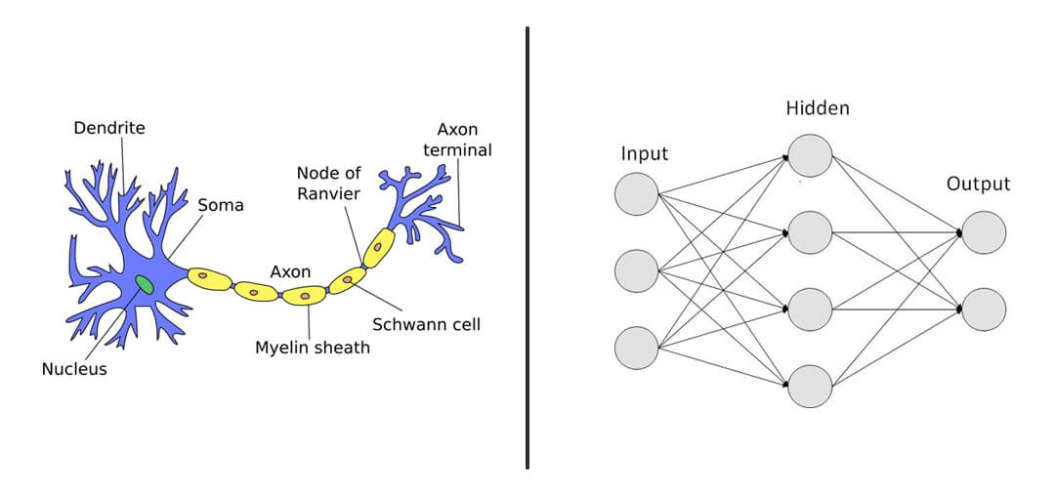
Neuron ,Neural Network and ANN
The biological neuron graph The artificial neural network

Slide 10
Neuron ,Neural Network and ANN
A neuron is nothing but a cell that collects the information's and disseminate the electrical signal in a brain.
A neural network or ANN is type of neural networks try to mimic the biological neural network.
Application of Neural Network
Speech Recognition
Character Recognition
Signature Verification Application
Human Face Recognition
Robotics Field
Why Neural Networks?
To find the solution of such problems for which algorithmic method is expensive or does not exist.
Neural networks can learn by example, hence we do not need to program it at much extent.
Neural networks have the accuracy and significantly fast speed than conventional speed.

Slide 11
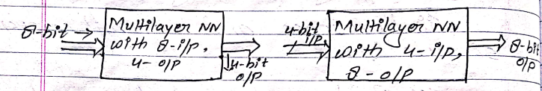
Applications of NN in Image Processing
NN for Image Compression
NN for Pattern Recognition
NN for Perceptron
NN for Image Compression

Slide 12
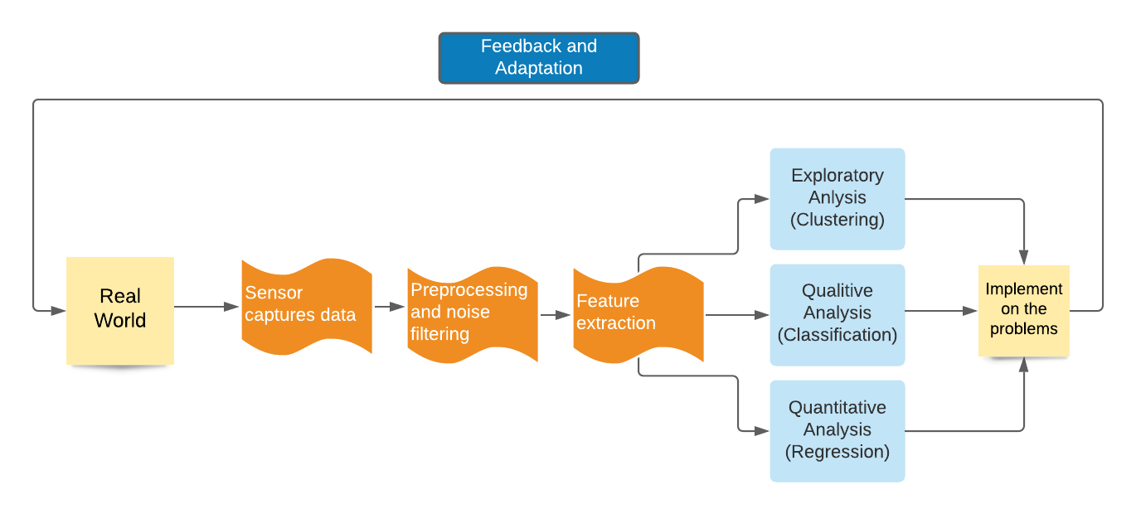
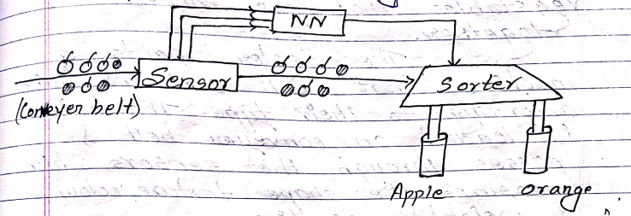
NN for Pattern Recognition

Slide 13
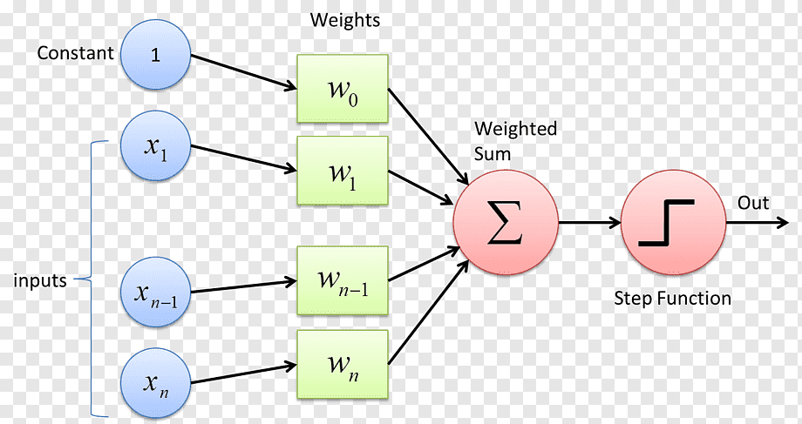
NN for Perceptron
Perceptron is a type of ANN that is computerized model which performs functions like human brain

Slide 14
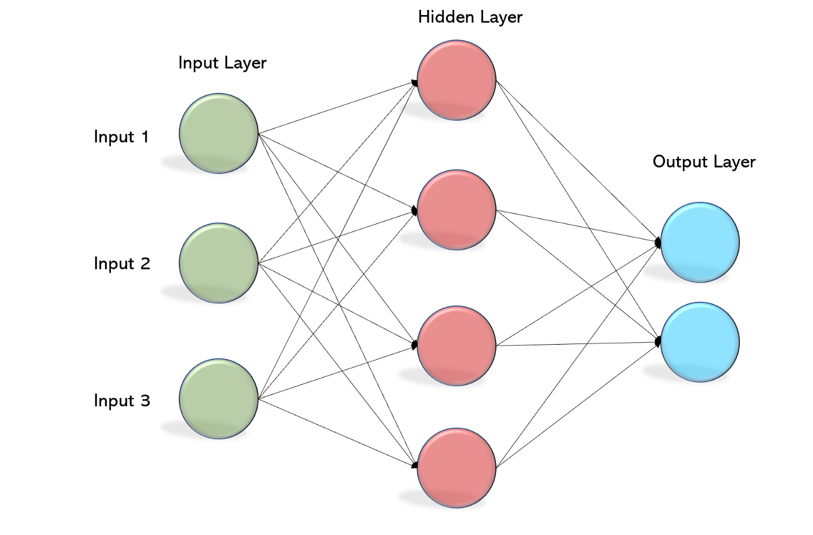
OUTPUT formation by perceptron i.e. MLP

Slide 15
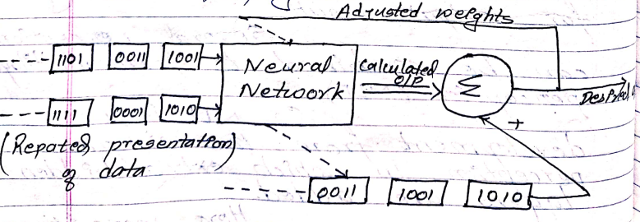
Back propagation

Slide 16
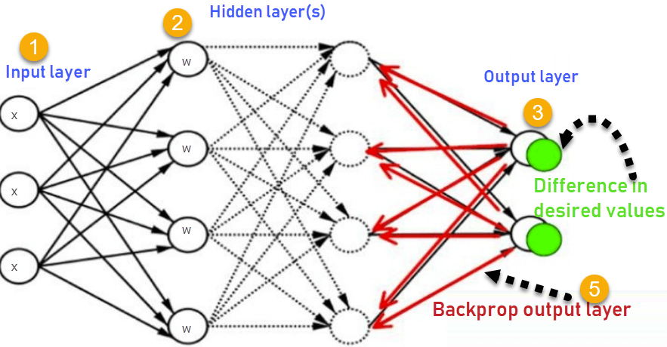
Backpropagation Network

